Slide 1
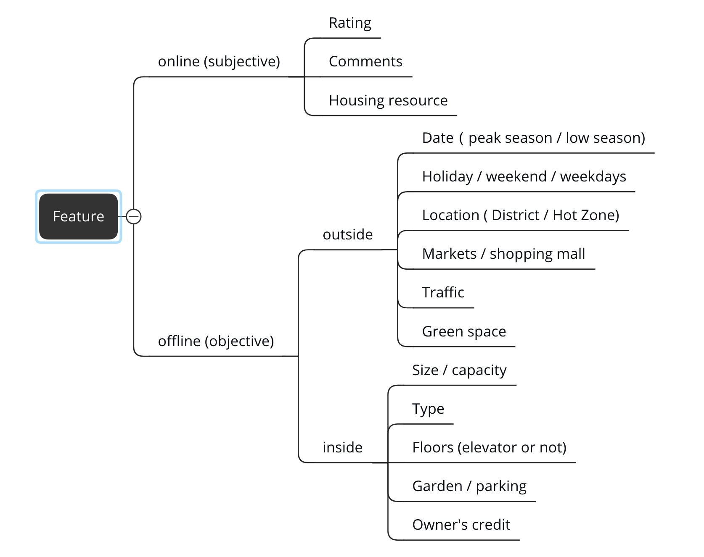
Get what we can get
Eyeballing
Pick features
Outliers
Related?
What kind relationship?

